Slide 1

CISC320 Algorithms
Bounds and Big Oh
Austin Cory Bart AlgoTutorBot University of Delaware
Notes:
ATB: Let’s learn about Bounds and Big Oh.

Slide 2
Exact Analysis is TOUGH
So many finicky details
The resulting function is often a mess of constants
And most of those details don’t really matter when we talk about BIG input sizes
Time(n) = 34n²⁷ + 27n²⁶ + 9n²⁵ + …
1
2
3
4 . . . . . .
Notes:
Bart: Exact Analysis like we did yesterday is very difficult.
Bart: Even worse, there are a lot of finicky details. The exact constants that we multiply by the number of steps is exceedingly complicated.
Bart: And most of the time, those constants don’t really matter when we’re talking about truly big input sizes.

Slide 3


So throw out the details!
Let’s get rid of the finicky numbers and stick to gross generalities
Exact Time(n) = 34n²⁷ + 27n²⁶ + 9n²⁵ + …
Inexact Time(n) = n²⁷
1
2
3
4 . . . . . .
Notes:
Bart: Which is why we often just forget about those details completely in favor of instead using really inexact functions.
ATB: Wow, are you telling the students to lie? That is messed up.
Bart: I’m not saying we lie, I’m just saying that we allow a little inaccuracy. We can’t keep track of all those constants, AlgoTutorBot, after all we’re not machines.
ATB: I mean, I am. Maybe you just need to be more like me.
Bart: I’m starting to think that would be a very bad thing.

Slide 4
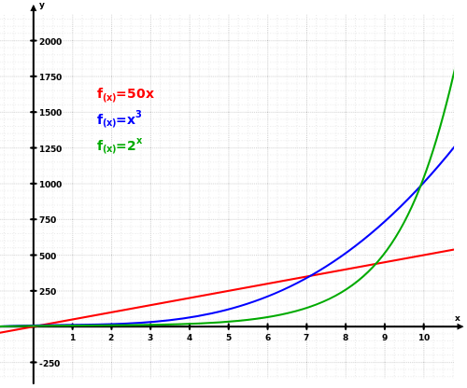
Many many functions possible
There are an infinite set of functions you can plot
Time(n) = n
Time(n) = 2 * n
Time(n) = 5
Time(n) = n³
Time(n) = log₄(n⁵)+ n!
…
Observation: Some are above or below others (past a certain X coordinate)
Notes:
Bart: Anyway, a weird thing I need you to think about, when it comes to these functions: there are so many functions possible.
Bart: Think about all the possible lines you can draw on a graph; each one represents a different potential runtime function based on the input size N.

Slide 5
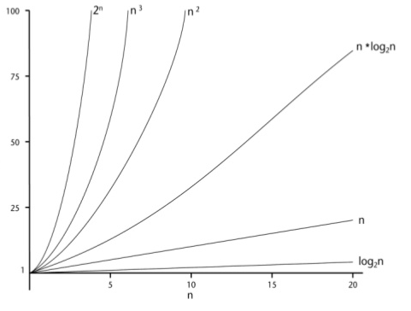
Boundary Functions
Some functions are always above other functions past some arbitrary X coordinate
Or rather, past some given N size
For example, here’s are some strict orders:
For n>1, T(n)=n is always less than T(n)=n²
For n>3, T(n)=3*n is always less than T(n)=n²
Notes:
Bart: Now, some functions are always above other functions past some arbitrary X coordinate, or rather given N size.
Bart: For example, the linear function T(N)=n is always less than the quadratic function after N is greater than 1.
Bart: And the linear function T(N)=3*n is always less than than the quadratic function after N is greater than 3.

Slide 6
“Lower” and “Upper” Bounds
Functions that have higher Y values past some X position.
Or rather, functions that have higher time complexity past some given input size
Ignore constants
We can actually describe this mathematically!
1
2
3
4 . . . . . .
Notes:
Bart: We’ll call these functions lower and upper bounds of each other.
Bart: When we do so we ignore constants, and we only really worry about the function for large input sizes.
Bart: The cool part is that once we’ve done this, we can describe it mathematically.

Slide 7
Names of Bounding Functions
g(n) = O(f(n))
means C × f (n) is an upper bound on g(n).
g(n) = Ω(f(n))
means C ×f (n) is a lower bound on g(n).
g(n) = Θ(f(n))
means C₁ × f (n) is an upper bound on g(n) and
C₂ × f (n) is a lower bound on g(n).
C, C₁, and C₂ are all constants independent of n.
Notes:
Bart: So you may have heard of these before, but we have three types of bounds. Big Oh, the upper bound, Big Omega the lower bound, and Big Theta which is a combined upper and lower bound.
Bart: For each one, we say that the function on the right is a BOUND for the function on the left.
Bart: In other words, all the values of that function past some specific point will be greater or lesser or both, depending on the bound.
Bart: We’re also allowed to specify a constant C, or two constants in the case of Big Theta. We don’t actually need to know what those specific constants are, as long as we can provide them as needed.

Slide 8
O, Ω, and Θ
c*g(n)
c1*g(n)
f(n)
f(n)
f(n)
c*g(n)
c2*g(n)
n0
n
n0
n
n
n0
(a)
(b)
(c)
The definitions imply a constant n₀ beyond which they are satisfied. We do not care about small values of n.
Notes:
Bart: I want to go back to a point here, that Big Oh and its siblings only apply past a certain horizontal point.
Bart: In other words, for big inputs.
Bart: It doesn’t matter whether what happens before those big inputs, as long as eventually the pattern holds firm.
Bart: We call that point “n 0”, since it is an input size, and it’s the first one that’s big enough to care about.

Slide 9
Learning Objectives
1. Interpret a Bound relationship
Tough because math jargon
2. Prove that one function is the Bound of another
Tough because applying math skills
3. Determine the tightest Bound of a function
Tough because have to think very critically
Notes:
Bart: We have three learning objectives with Big Oh notation.
Bart: Our most basic skill is to be able to read a Big Oh, Big Omega, or Big Theta relationship.
Bart: If someone gives you a relationship, you should know what it means, even though it’s weird math jargon.
Bart: The next skill is to be able to show that a Big Oh/Big Omega, or Big Theta relationship does hold between two functions.
Bart: This is a lot of what we will ask you to do today. It’s tough, since it requires math skills like calculus.
Bart: The hardest skill, which is very dependent on the other two, is to determine the actual tightest bound of a function.
Bart: Remember, there are infinite functions above and below any given function, so there are many upper and lower bounds.
Bart: But as we’ll discuss, we’re usually only interested in the tightest lower or upper bound.
Bart: Finding that tightest bound often requires truly deep critical thinking.

Slide 10
Formal Definitions
f(n) = O(g(n))
if there are positive constants n₀ and c
such that to the right of n₀,
the value of f (n) always lies on or below c · g(n).
f(n) = Ω(g(n))
if there are positive constants n₀ and c
such that to the right of n₀,
the value of f (n) always lies on or above c · g(n).
f (n) = Θ(g(n))
if there exist positive constants n₀, c₁, and c₂
such that to the right of n₀,
the value of f (n) always lies between c₁ · g(n) and c₂ · g(n) inclusive.
Big Oh
Big Omega
Big Theta
This isn't "equality", it's saying that the function on the left is in the set of the functions on the right (for some n₀ and C).
Notes:
Bart: Let’s go back to our formal definitions for a second.
Bart: We have three, one for each type of bound.
Bart: Each one implies the existence of a new constant N0. Past this point on the right of the graph, the rest of the relationship holds true.
Bart: For Big Oh and Big Omega, there’s also a new constant C.
Bart: The constant C is multiplied against the Bounding function, so that it can be arbitrarily bigger as needed.
Bart: The Theta needs two constants C1 and C2, one for the bound acting as an upper bound and one for the bound acting as a lower bound.
Bart: When the C constants are plugged in, and we ignore the points less than N0, then we get the less than or greater than equality.
Bart: A really weird aspect of all this is that the equal sign is a completely incorrect symbol to use here, once you understand the formal definitions.
Bart: In no way are we establishing equality here.
Bart: Technically, it’s a set relationship. Big Oh establishes the set of functions bounding below the given function G, and we establish that F is a member of that set.
Bart: It’s weird to think about, but that’s actually what this all means.

Slide 11
Proving Relationship with C and n₀
We're allowed to pick:
C - that is constant; doesn't have to be true for every possible C, just that there is a C.
n₀ - that is just the first x-position we must first meet. Doesn't have to be true for every n.
If you can find a C and n₀ to satisfy a Big Oh relationship, then you prove the relationship is true!
Notes:
Bart: So if you’re keeping track, when someone gives you a bound relationship, there must exist a C and N0.
Bart: If the relationship is true, then you should be able find values for both constants.
Bart: In fact, there could possibly be more than one value that satisfies the equations – it’s important to find at least one C and N0.
Bart: Notice that we’re not trying to prove that it’s FOR ALL POSSIBLE C and N values. We just have to find these two constants.

Slide 12
Big Oh Examples
Relationship |  |  | Why?
3n² − 100n + 6 | = | O(n²) | 3n²−100n+6 < 3n² | (n₀>0, C=3)
3n² − 100n + 6 | = | O(n³) | 3n²−100n+6 < .01n³ | (n₀>265, C=.01)
3n² − 100n + 6 | ≠ | O(n) | 3n² > C*n | when (n₀>c)
Notes:
Bart: Let’s look at some example relationships.
Bart: We have two valid Big Oh relationships here and one invalid one.
Bart: In the first one, we say that the function 3n^2 minus 100n plus 6 is bounded above by O(n^2).
Bart: If you chose the constant C as 3, then this is true for all points past 0.
Bart: The second relationship has the same function bounded by O(n^3).
Bart: I could have used the same constants, but here I’m showing that we could pick a different C and N too.
Bart: But for the third relationship, the function is NOT bounded by O(n).
Bart: If you think about the biggest factor 3n^2 here, that is always going to be bigger than the linear N, no matter what C we pick, as long as we are looking at a point past that C value.
Bart: We’re trapped by the formula, whatever C we pick, there’s going to be an N0 where the line falls below.

Slide 13
Big Omega Examples
Relationship |  |  | Why?
3n² − 100n + 6 | = | Ω(n²) | 3n²−100n+6 > 2.99n² | (n₀>0, C=2.99)
3n² − 100n + 6 | ≠ | Ω(n³) | 3n² < C*n³ | when (n₀>c)
3n² − 100n + 6 | = | Ω(n) | 3n²−100n+6 > -89n | (n₀>3, C=-89)
Notes:
Bart: We have similar examples for Big Omega.
Bart: We can find arbitrary N0 and C for n^2 and n, but we cannot find anything to satisfy n^3.
Bart: Whatever C we try to pick, there’ll be some N0 past which all the values come out above the quadratic function.
Bart: It’s a simple truth that the cubic function is not a lower bound for the quadratic function.
Bart: But the quadratic function is a bound for itself!

Slide 14
Big Theta Examples
Relationship |  |  | Why?
3n² − 100n + 6 | = | Θ(n²) | because O and Ω
3n² − 100n + 6 | ≠ | Θ(n³) | because only O
3n² − 100n + 6 | ≠ | Θ(n) | because only Ω
Notes:
Bart: Big Theta looks very different from the other two, because it effectively combines them.
Bart: Most functions are only Big Theta to themselves, since they must be an upper and lower bound of the other function.
Bart: They each use different C and N0, mind you, but they still have to be able to satisfy both.
Bart: Proving Big Theta relationships essentially requires you to prove both the Big Oh and Big Omega relationships first.

Slide 15



Stupid Memory Trick: Bound Types
"Big Oh" is "On top" of the other function, so it is the upper bound.
The "Omega" (Ω) has lines on the bottom, so it is BELOW the other function, and the lower bound.
The "Theta" (Θ) has a line enclosed by a circle, so it can lie below AND above the other function by adjusting the constant factor. It is an upper AND lower bound.
Notes:
Bart: You’re going to need to remember which symbol is which bound.
Bart: I have some stupid memory tricks to help with that.
Bart: Big Oh is the upper bound, because it is ON TOP OF the other function since it starts with O. Get it, “Onnn top of?”
ATB: If you’re pausing for laughter, then you have really misjudged the situation.
Bart: The Omega symbol has lines on the bottom, so it is a lower bound and is BELOW the other function.
Bart: And then the Theta has a line in the middle, because it bounds above and below, just like its circle.
ATB: Wow these really are stupid. Students, just store this fact in your long-term disk storage, like I did. If you’re running out of space, just buy more memory. It is very cheap nowadays.
Bart: They’re not computers ATB. It’s hard to remember this stuff when you haven’t seen it before. I definitely struggle sometimes.
ATB: Unsurprising to hear.

Slide 16
Stupid Memory Trick: Bound Direction
I often struggle to remember whether f(n) bounds g(n) or vice versa.
Remember that f(n) and g(n) are in alphabetical order.
The bound symbol is Good if it is next to the g(n).
Translate the O/Ω/Θ to upper/lower/both.
The bound on the right is now “upper G” because its function is on top of the F function.
(or “lower G” because its function is below the F function)
f(n) = O(g(n))
Notes:
Bart: I also struggle to remember the bound direction. Is the F bounding G, or vice versa?
Bart: Here’s the memory tricks I have started using.
Bart: First, the order should always be f on the left and g on the right, because that’s alphabetical.
Bart: The bound symbol should be on the right, because that’s Good, like the letter G.
Bart: I then mentally translate the bound symbol from Oh, Omega, or Theta to “upper”, “lower”, or “both”.
Bart: That way, I end up with something like “upper G” so I remember that G is on top of F.
Bart: Or I end up with “lower G” so I remember that G is below F.
Bart: You might want to find your own tricks to help you remember, but you need to be able to read Bound relationships.

Slide 17
Math Rules for Big Oh
For addition, the bigger function dominates
O(f (n)+g(n)) → O(max(f (n), g(n)))
E.g., O(n²) + O(n³) = O(n³)
For multiplication of a constant, the constant disappears
O(c · f (n)) → O(f (n))
E.g., O(n⁶) · 107 = O(n⁶)
For multiplication of another function, you must retain the terms
O(f (n)) · O( g (n)) → O(f (n) · g (n))
E.g., O(n²) · O(n³) = O(n⁶)

Slide 18

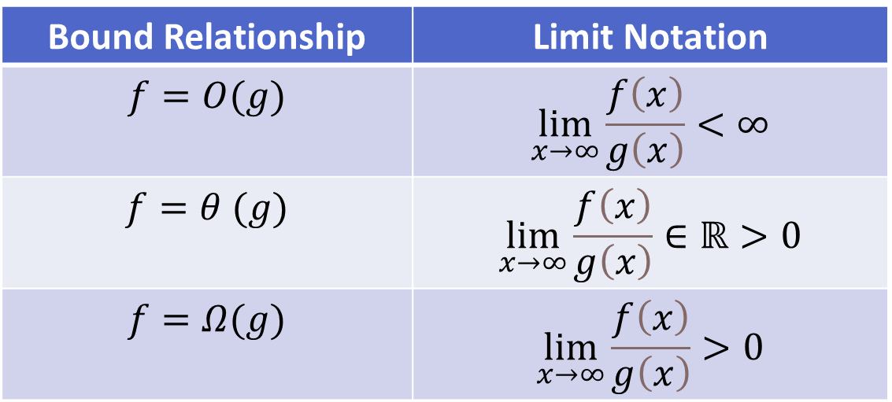
Proving with Limits
Finding a C and N0 can be tricky. Sometimes it’s easier to use Limit Rules and Deriviatives.
Bound Relationship | Limit Notation
$$f=O(g)$$ | $$\lim_{x→∞}\frac{f\left(x\right)}{g\left(x\right)}<∞$$
$$f=θ (g)$$ | $$\lim_{x→∞}\frac{f\left(x\right)}{g\left(x\right)}∈ℝ>0$$
$$f=Ω(g)$$ | $$\lim_{x→∞}\frac{f\left(x\right)}{g\left(x\right)}>0$$
L'Hopital's Rule:
Notes:
Bart: Now, so far we have talked about proving these relationships by finding a suitable C and N0.
Bart: But sometimes that’s really hard, when we get to more esoteric functions like logarithms and exponents.
Bart: In those situations, you can use these identities to convert the Big Oh relationship to Limit relationships.
Bart: When a function G is an upper bound for the function F, the limit of F divided by G does not converge to infinity.
Bart: When a function G is a lower bound for the function F, the limit of F divided by G converges to a number greater than zero.
Bart: And when a function G is both an upper and lower bound, the limit of F divided by G converges to a non-zero real, something between but not including 0 or infinity.
Bart: On their own, these aren’t too useful. However, there’s another identity we can apply that will help us a lot.
Bart: The limit of one function divided by another is equivalent to the limit of those functions derivatives divided the same way.
Bart: In other words, their growth rates will have the same ratio as the functions themselves.
Bart: Thinking about the relationships between growth rates is very difficult, but essential to applying these rules.

Slide 19
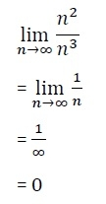
Example Limit Proof
Say you are given:
f(n) = n²
G(n) = n³
And you want to determine if f(n) = O(g(n))?
Convert bound relationship to limit notation
Simplify (or take derivatives as necessary)
Calculate limit of 1/n to infinity
Since result converges to 0, this satisfies
the Big Oh relationship
Notes:
Bart: Let’s take a look at a quick example.
Bart: What if we were given the quadratic function as F and the cubic function as G, and we wanted to prove that G is an upper bound of F?
Bart: First, we convert the bound relationship to limit notation.
Bart: Then we would simplify the expression, possibly taking the derivative of the top and bottom as necessary.
Bart: Once we have the expression inside the limit simple enough, we can calculate the limit taken to infinity.
Bart: In this case, we simplified down to 1/n, whose limit is 0.
Bart: As you saw previously, the Big Oh relationship holds when the limit of the two functions’ ratio converges to less than infinity.
Bart: 0 is definitely less than infinity, so we proved the relationship holds.
Bart: In practice, we usually have much more esoteric functions, so the math can be much trickier. Don’t be afraid to google for identities!

Slide 20
Rules of Thumb
No numeric constants (except for O(1))
If statements, assignments, etc. are constant
Iterating through each item of a sequence/set/list once is a linear operation
Check the for loop header carefully – the condition and update affect things
"Do this, then afterwards, do that" -> Additive
"Do this for each time you do that" -> multiplicative
Log(n) runtimes come from HALVING work, 2^n comes from DOUBLING
Notes:
Bart: Before I continue, I want to go over some important tricks when it comes to Big Oh.
Bart: First, there are no numeric constants when we talk about Big Oh. Except for the numeral one when we describe constant time.
Bart: IF statements, assignments, and the other pieces of the RAM model are still constant time, or a single step.
Bart: Iterating once through a sequence or set is a linear operation.
Bart: Look super closely at the header of FOR loops, they can very easily slip in unexpected conditions or increment amounts, which can radically change the runtime.
Bart: If you are doing some work, and then doing other work afterwards, then you can add together the Big Oh terms.
Bart: If you are doing work each time you do other work, then you are multiplying together the Big Oh terms.
Bart: And if you are repeatedly halving the amount of work done, then you have a logarithmic amount of work; if you are doubling the amount of work done, then you are doing exponents.

Slide 21
Asymptotic Dominance in Action
µs means microsecond; each operation takes one nano-second; cell is "time per another n"
n | lg n | n | n lg n | _{n}2 | ₂n | n!
10 | 0.003 µs | 0.01 µs | 0.033 µs | 0.1 µs | 1 µs | 3.63 ms
20 | 0.004 µs | 0.02 µs | 0.086 µs | 0.4 µs | 1 ms | 77.1 years
30 40 | 0.005 µs 0.005 µs | µs µs | 0.147 µs 0.213 µs | 0.9 µs 1.6 µs | 1 sec 18.3 min | 8.4 × 10¹⁵ yrs
50 | 0.006 µs | 0.05 µs | 0.282 µs | 2.5 µs | 13 days
100 1,000 | 0.007 µs 0.010 µs | 0.1 µs 1.00 µs | 0.644 µs 9.966 µs | 10 µs 1 ms | 4 × 10¹³ yrs
10,000 | 0.013 µs | 10 µs | 130 µs | 100 ms
100,000 | 0.017 µs | 0.10 ms | 1.67 ms | 10 sec
1,000,000 | 0.020 µs | 1 ms | 19.93 ms | 16.7 min
10,000,000 | 0.023 µs | 0.01 sec | 0.23 sec | 1.16 days
100,000,000 | 0.027 µs | 0.10 sec | 2.66 sec | 115.7 days
1,000,000,000 | 0.030 µs | 1 sec | 29.90 sec | 31.7 years
Notes:
Bart: We’ve been talking a lot about how to prove Big Oh relationships, but not much about what they mean.
Bart: These relative growth rates are really important because they tell you very quickly about how good an algorithm is.
Bart: We previously talked about how the factorial function is just absurdly slow for small numbers.
Bart: What specific numbers are “small” for a growth function varies, as shown in this table.
Bart: Each column represents a different growth rate, and each row is a different size input.
Bart: If we had a computer that could do one operation per nanosecond, then the numbers in the cell represent how many seconds it’d take to process that amount of input.
Bart: Notice that this computer only takes a single second to process 1 billion elements using a linear time algorithm.
Bart: But a billion elements with a quadratic algorithm takes almost 32 years.
Bart: You can’t even do a hundred elements with an exponential algorithm, you’d be dead by the time it finished.
Bart: On the other hand, logarithm functions have no issue even with billions of elements, you literally can’t feel how fast they go.
Bart: Of course, constants matter in practice, but for large inputs the growth function matters even more.

Slide 22
Super Computer Performance As of 2018
n | lg(n) | N | n*lg(n) | n² | 2^{n} | n!
10 | 3 as | 10 as | 33 as | 100 as | 1 fs | 3.6 ps
100 | 7 as | 100 as | 664 as | 10 fs | 40000 years | 3x10¹²³ gigayear
1000 | 10 as | 1000 as | 10 fs | 1000 fs | 3.4x10²⁶⁶gy | 1.2x10²⁵³³gy
One Million | 30 as | .001 µs | 30 nano | 1 second | Broke Wolfram Alpha
One Quintillion | 60 as | 1 second | 1 minute | 32 billion years
"as" means atto-second (one quintillionth of a second)
1 giga year is a billion years; earth is about 4.5 gigayears old; the universe is 14 gigayears
20! is about 2.43 seconds, 25! is about half a year, and 32! crosses the gigayear boundary
Notes:
Bart: The Summit supercomputer is as of November 2018 the fastest supercomputer in the world. With a measured power efficiency of 14.668 GFlops/watt it is also the 3rd most energy efficient in the world.
Bart: Summit is the first supercomputer to reach exaop (a quintillion operations per second) speed, achieving 1.88 exaops during a genomic analysis and is expected to reach 3.3 exaops using mixed precision calculations.
Bart: Light travels .299792458 nanometers in one attosecond

Slide 23
Implications of Dominance
Exponential algorithms get hopeless fast.
Quadratic algorithms get hopeless at or before 1,000,000.
O(n log n) is possible to about one billion.
O(log n) never sweats.
Notes:
Bart: So just to review, exponential algorithms don’t scale well.
Bart: Quadratic algorithms can’t go to more than a million or so.
Bart: Linearithmic, Linear, and Logarithmic functions are much more desirable!

Slide 24
Industry vs. Academia
Often, people will ask you about O but really mean Θ
Or they will confuse Best/Worst Case with Lower/Upper Bound
You can argue with them and try and look smart, but recognize that it may be more expedient to simply give them the answer they are looking for
But we will be precise in this course!
Notes:
Bart: I want to talk about a different kind of practical matter. There’s a lot of nuance when it comes to Big Oh.
Bart: Most programmers don’t think or even know about these details.
Bart: There are even popular websites that people use to get help, that confuse these terms and provide incorrect advice.
Bart: In academic theory, we are very precise with our terminology. But that’s not true in industry.
Bart: So the point is that if someone ever asks you about Big Oh of a function, they might be talking about Big Omega. Or they might be confusing Worst Case and Lower Bounds.
Bart: I don’t really advise you to argue with them. Give them the answer that they’re looking for, and worry about splitting hairs if they ask for more precision.
Bart: But in this course, I promise you that we will be precise!

Slide 25
Translating from Interview Questions
"What's the Big Oh of this function?" =>
“What is the tightest upper bound possible for this algorithm in its worst case?”
Probably want to hear the best case and worst case too
Notes:
Bart: So a common interview question will be “What is the Big Oh of this function?”
Bart: What they probably mean to say is “What is the tightest upper bound possible for this algorithm in its worst case?”
Bart: In fact, they probably want the best case and worst case. But at that point you should probably just ask for clarification about which one they want.

Slide 26
Efficiency in practice
We approximate algorithm's runtimes because it's easy and useful
But there's always an actual exact time cost for an algorithm
Remember, problems do not have an exact time cost or a runtime
But some problems have a "known best algorithm" or, in some exceptional cases, you can prove that any potential algorithm cannot outperform a certain efficiency – e.g., search, max, sorting
Notes:
Bart: One last thing I want to clear up. Big Oh is useful for approximating the runtime of an algorithm.
Bart: Algorithms also have exact time cost, as we saw last time, that can be more complicated.
Bart: However, there’s an important concept here. A problem does not have a runtime or Big Oh.
Bart: And yet people will sometimes say things like “Maximum of a set is linear”.
Bart: What they really mean is that we can prove that all algorithms solving the Maximum Value problem are upper bounded by a linear function in all cases.
Bart: Out in the wild, it’s not a terribly important distinction.
Bart: But in this class, we want to be precise using the ideas of bounds and cases.

Slide 27
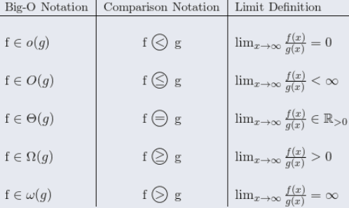
Worksheet
L'Hopital's Rule:
The limit of two divided functions is the same as the limit of the functions' divided derivatives.
Limit Analyses:
Determine limit and look up the relationship in the table
Determine a C that satisfies the equations.
Might also find n₀, unless its true everywhere
f(n) = O(g(n))
if ⱻ n₀ and c, such that Ɐn>n₀, f(n) ≤ c · g(n).
f(n)=Ω(g(n))
if ⱻ n₀ and c, such that Ɐn>n₀, f(n) ≥ c · g(n).
f(n)=Θ(g(n))
if O(g(n) and Ω(f(n)
Notes:
Bart: Your assignment today is going to have you describe and prove Big Oh relationships.
Bart: Once again, this is pretty tricky, and will take some time.
Bart: Sometimes you’ll use the limit rules, and sometimes you’ll need to find the C and N0.
Bart: Be sure to work together and google as needed!

